Slide 1

NIGERIA COVID-19 DATA ANALYSIS WITH PYTHON
BY
PROSPERITY CHIAMAKA OGUAMA

Slide 2

PROJECT OVERVIEW
The global outbreak of the coronavirus (COVID-19) has reshaped societies and economies, compelling nations to confront new challenges in healthcare, economy, and daily life.
The onset of Covid-19 in Nigeria was observed on February 27, 2020, marking a critical juncture in the nation's response to the pandemic.
This data science project aims to leverage analytics techniques to unravel insights from the Covid-19 data specific to Nigeria.
The goal is to gain a comprehensive understanding of the disease's impact on various regions within the country and to explore intricate relationships between different variables and the reported number of cases.

Slide 3
STEPS AND APPROACHES
Data Collection and Web Scraping: 3 datasets were used: 1) The NCDC Covid-19 data from their official website (https://covid19.ncdc.gov.ng/) 2) The Johns Hopkins University (JHU) data on daily confirmed, death, and recovered cases across different countries 3) The Nigeria Community Vulnerability Index Data.
Data Cleaning and Merging: The data of interest was extracted from the 3 data sources, cleaned, and merged to form a dataframe.
Data Analysis: Numpy, Matplotlib, and Seaborn were used to perform visualization to extract insights from the collated data.

Slide 4
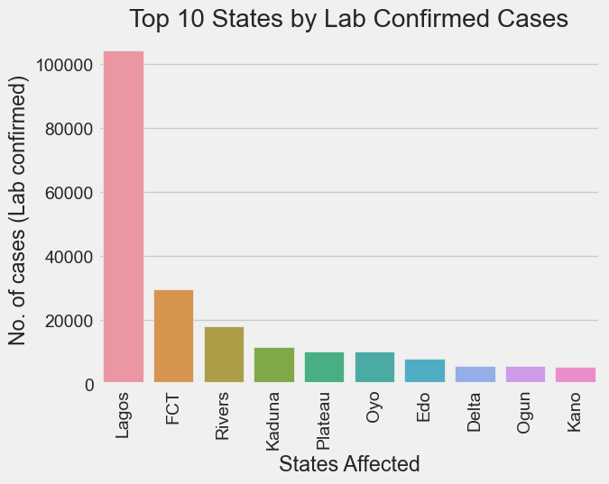
KEY INSIGHTS
The states with the highest number of lab-confirmed Covid-19 cases were Lagos, the Federal Capital Territory (FCT), and Rivers State.
These states also recorded the highest number of discharged cases.
Lagos, Edo State and the FCT recorded the highest number of deaths.

Slide 5
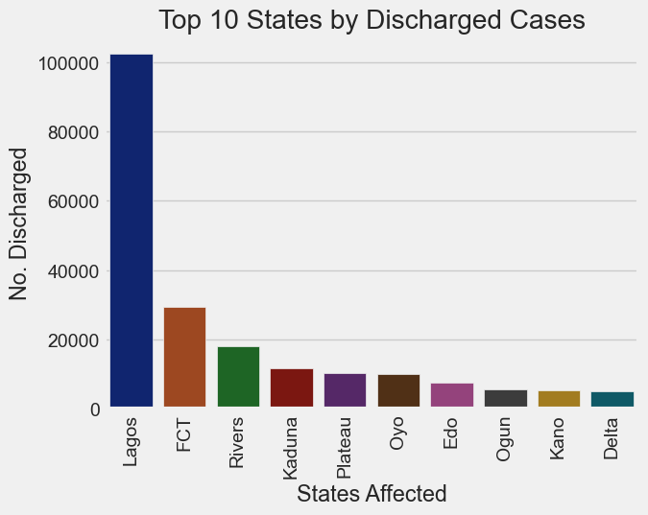
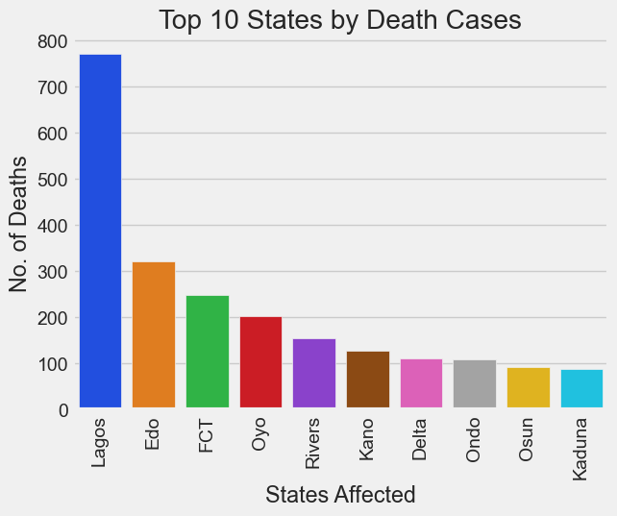
KEY INSIGHTS

Slide 6
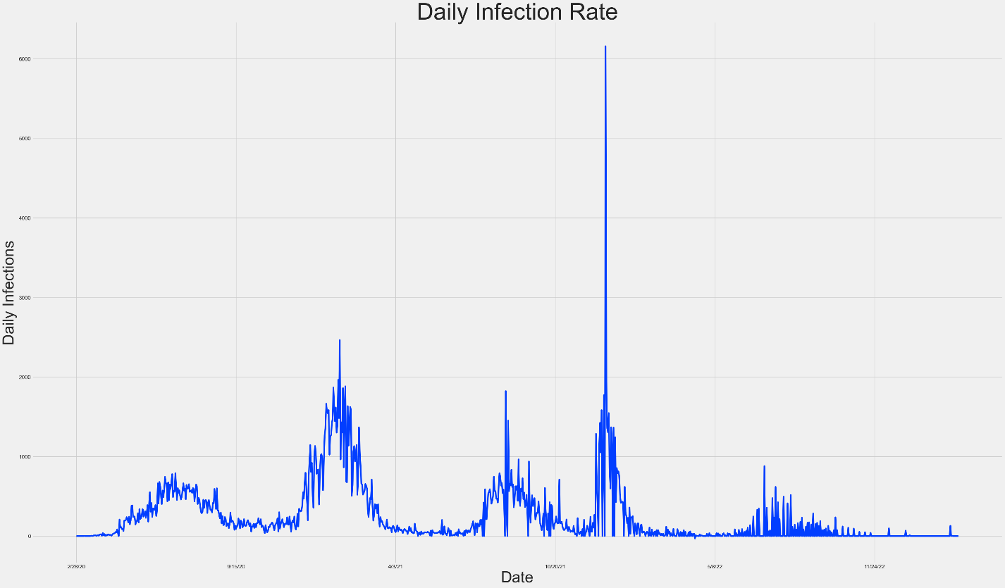
KEY INSIGHTS
The maximum number of cases was recorded on the 22nd of December, 2021.
This date is represented by the highest peak in the plot of daily infection rate.

Slide 7
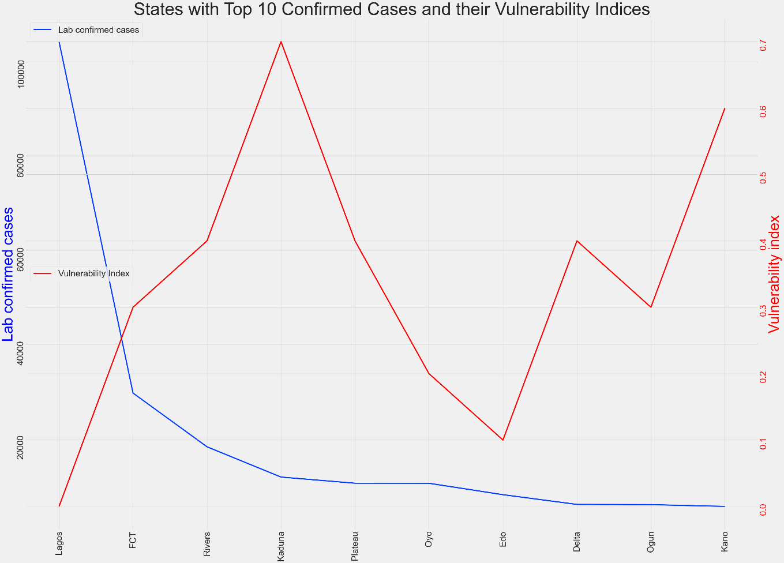
KEY INSIGHTS
In the context of Covid-19, the vulnerability index is the measure of exposure of a population to the negative impacts of the pandemic.
One would expect to find a relationship between the vulnerability index and the number of lab-confirmed cases (more vulnerable locations will be expected to report more cases).
However, this is not the case, as is evident from the plot of Lab confirmed cases against Vulnerability index for the 10 states with the highest number of cases.

Slide 8
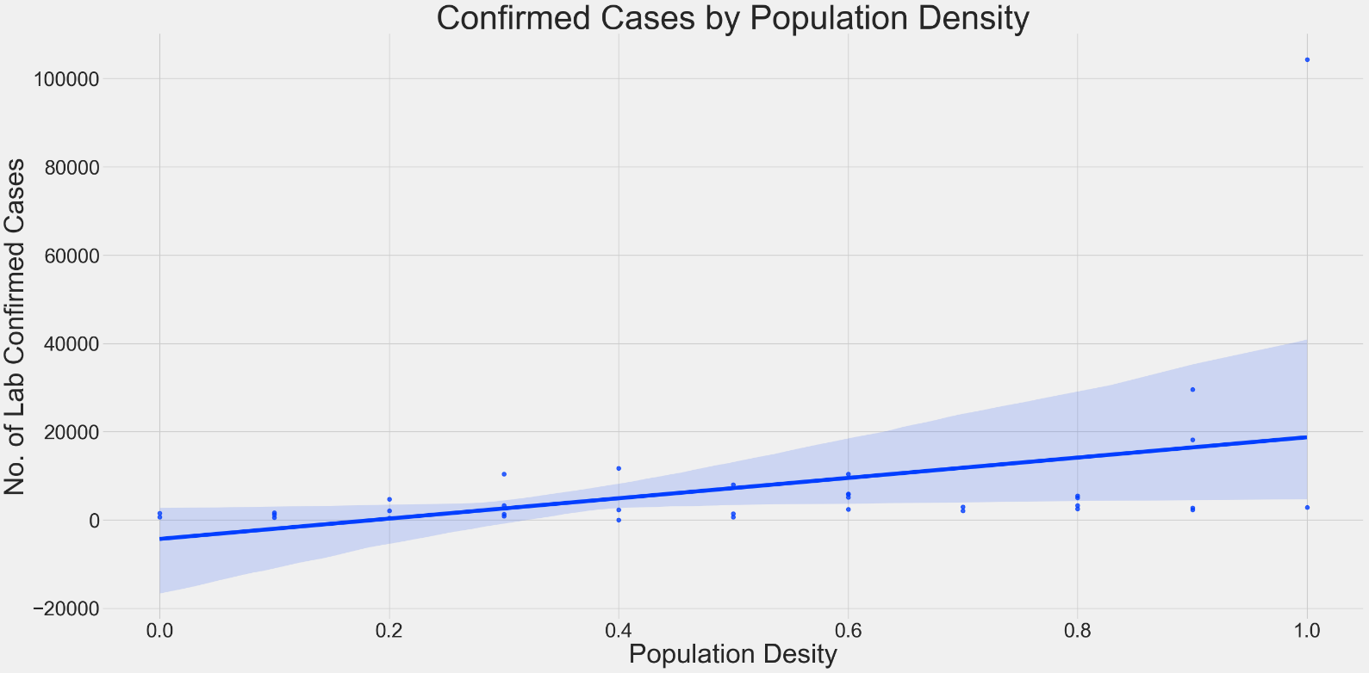
KEY INSIGHTS
There is generally an increase in the number of lab-confirmed cases with increasing population density.

Slide 9
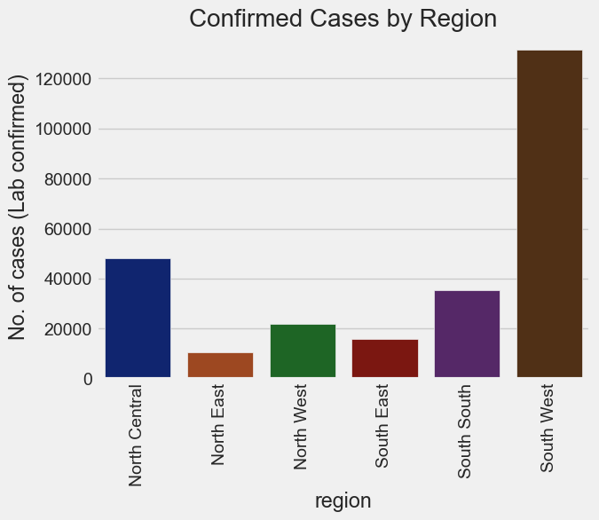
KEY INSIGHTS
The top 3 geopolitical zones with the highest number of cases were the South West, North Central, and South South respectively.
The major contributor to the numbers in the South West is Lagos, while the major contributors in the North Central and South South are the FCT and Rivers State respectively.

Slide 10
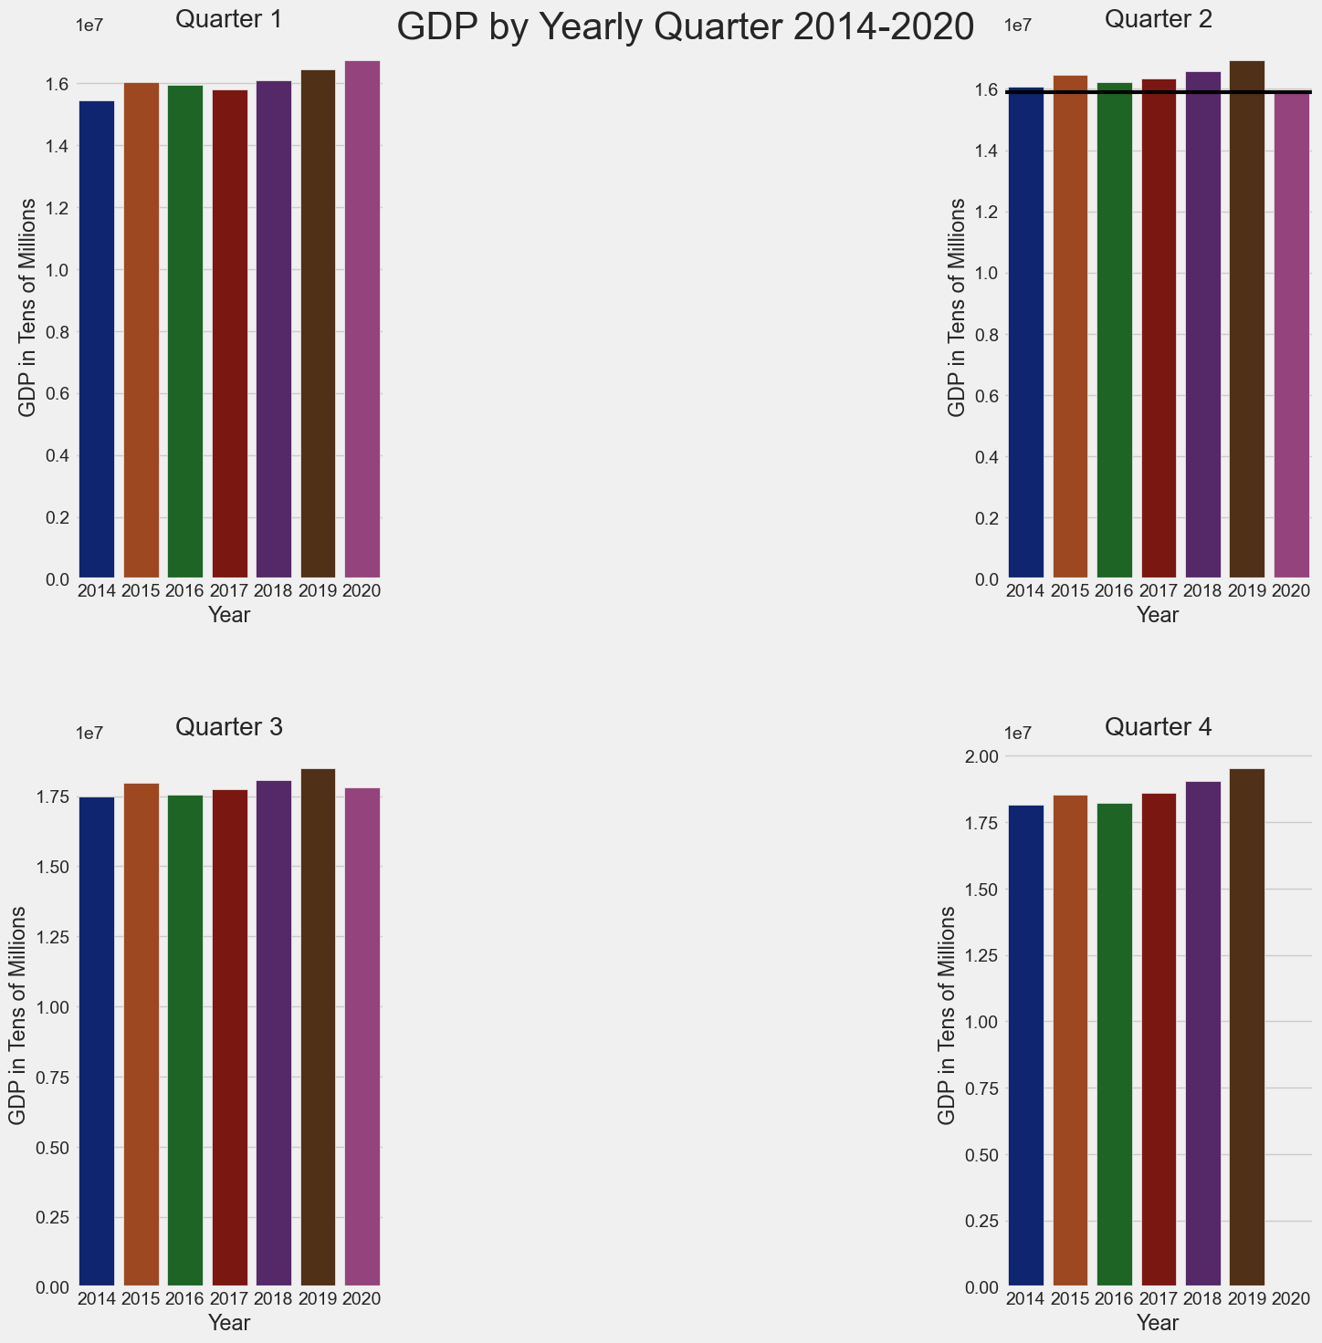
KEY INSIGHTS
Nigeria's GDP experienced a notable increase in the first quarter of 2020 compared to previous years.
However, following the arrival of Covid-19 into the country in February, the economy experienced a decline in the second quarter of 2020.
This decline is evident in the Q2 GDP value being at its lowest in 2020 compared to previous years (2014 to 2019).

Slide 11
CONCLUSION
Lagos, the FCT and Rivers State were the most affected by the Covid-19 pandemic in Nigeria.
States with higher population densities were more prone to the spread of the virus.
The South Western region of Nigeria recorded the highest number of cases.
The nation’s economy was adversely affected by the spread of Covid-19 and the lockdown it warranted.

Slide 12
FUTURE WORK
Future work on this project will involve the integration of more datasets to uncover more insights related to the effects of Covid-19 on the Nigerian economy.
Investigation into the impact of vaccination on Covid-19 effects, both health-wise and economically.
Comparative analysis of Nigeria’s response and outcomes with other countries to gain insights and lessons for future pandemic preparedness.

Slide 13
THANK YOU

